Slide 1
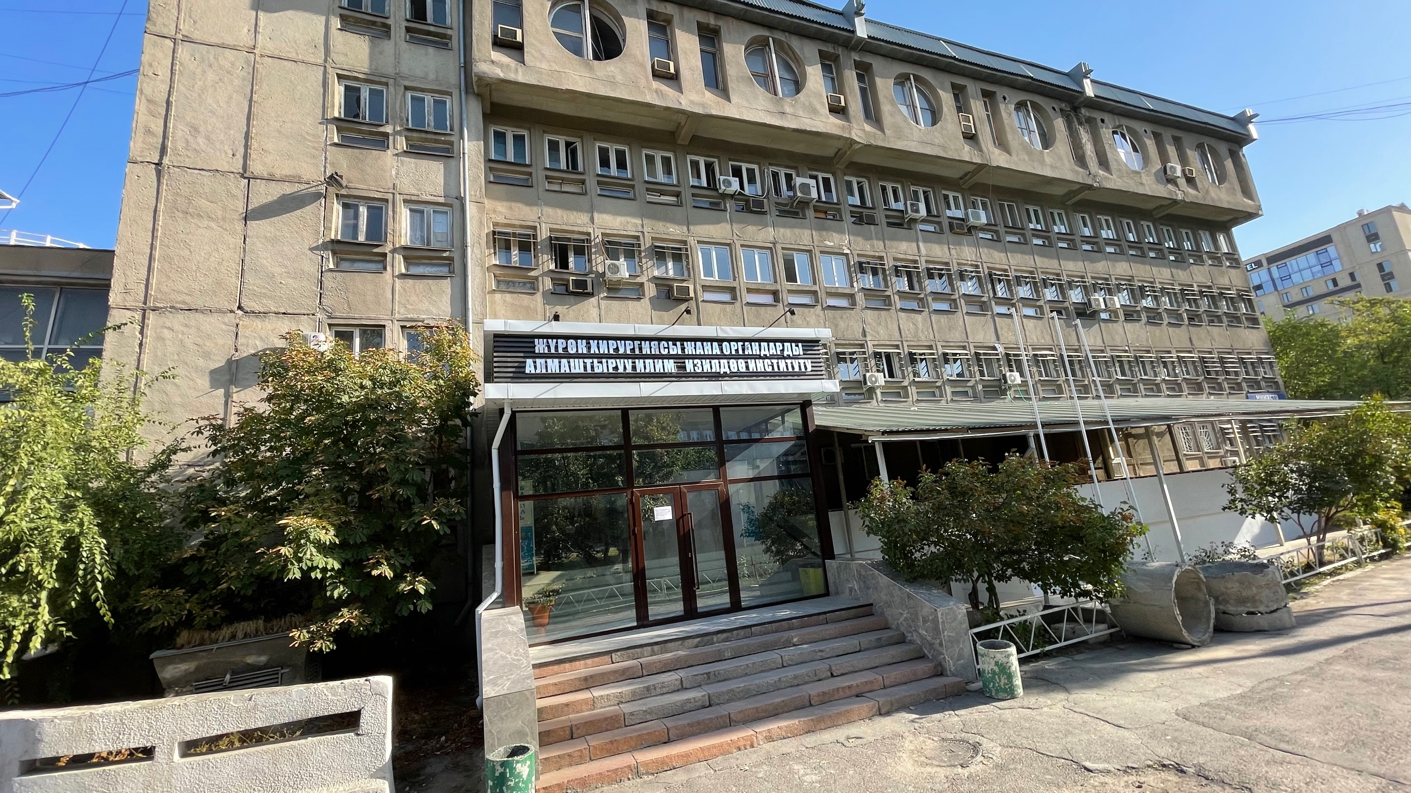

Atrial Fibrillation:
What we are treating?
Abai Turdubaev
Assoc. Prof., MD, PhD
«Scientific Research Institute of Heart Surgery and Transplantation»
Young ambassador of EHRA in Kyrgyz Republic
Bishkek, Kyrgyzstan

Slide 2


AGENDA
Guidelines
Prevalence
What we are treating?
Summary
11-th National Congress of the Azerbaijan Cardiology Society

Slide 3
AGENDA
Guidelines
Prevalence
What we are treating?
Summary
11-th National Congress of the Azerbaijan Cardiology Society

Slide 4
Guidelines
11-th National Congress of the Azerbaijan Cardiology Society

Slide 5

Epidemiology of AF: prevalence
11-th National Congress of the Azerbaijan Cardiology Society

Slide 6
Why it’s so common?

Slide 7
Summary of risk factors for incident AF
11-th National Congress of the Azerbaijan Cardiology Society

Slide 8
4S-AF scheme as an example of structured characterization of AF
11-th National Congress of the Azerbaijan Cardiology Society

Slide 9
Tools for screening
11-th National Congress of the Azerbaijan Cardiology Society

Slide 10
Sensitivity an specificity of various AF screening tools considering the 12-lead ECG as the gold standard
11-th National Congress of the Azerbaijan Cardiology Society

Slide 11
Why screening is so important?

Slide 12
11-th National Congress of the Azerbaijan Cardiology Society

Slide 13
What we are treating?

Slide 14
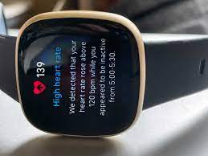
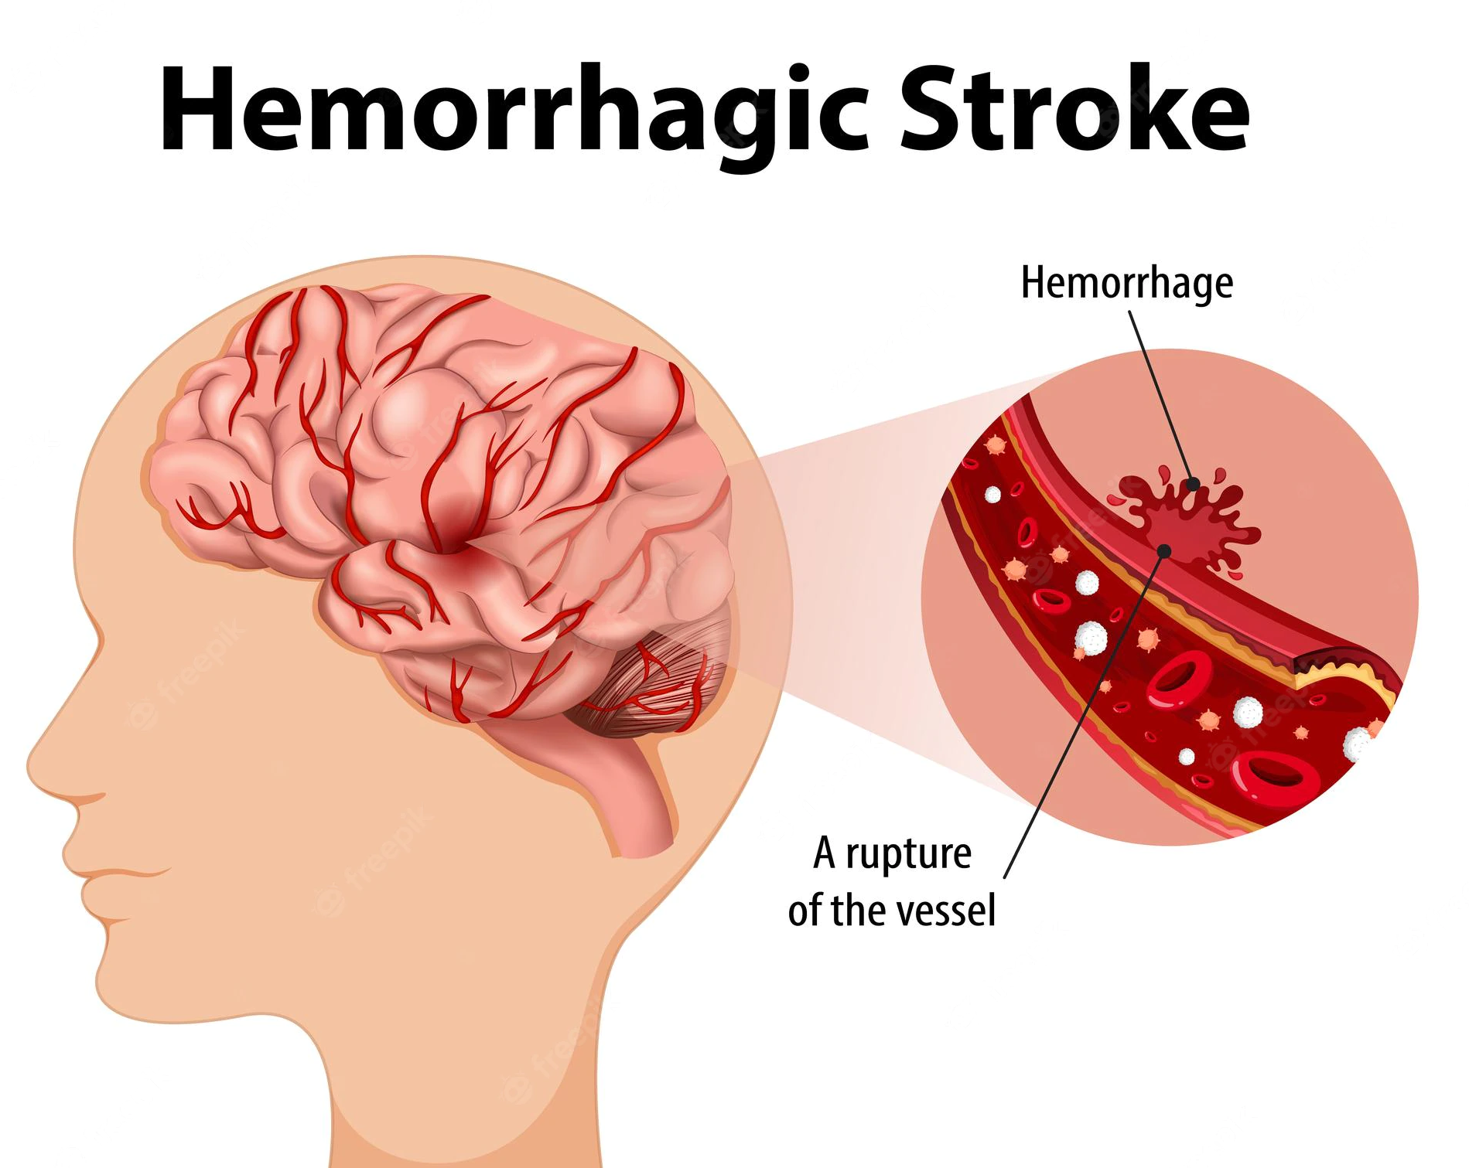
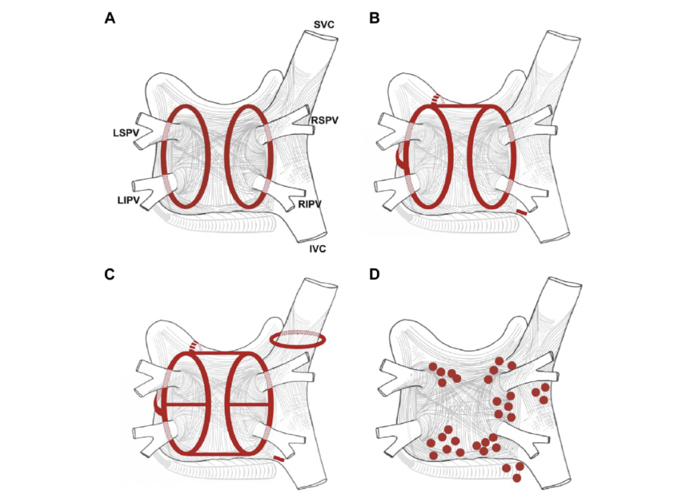
Rate control
PVI
2017 HRS/EHRA/ECAS Consensus Statement on AF ablation.
Calkins H et al. Heart Rhythm. 2017;14:275-444.
11-th National Congress of the Azerbaijan Cardiology Society

Slide 15
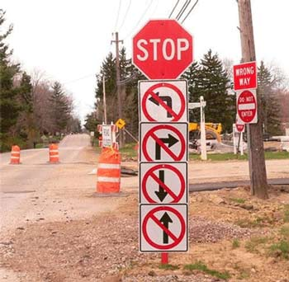


Slide 16
11-th National Congress of the Azerbaijan Cardiology Society

Slide 17
11-th National Congress of the Azerbaijan Cardiology Society

Slide 18
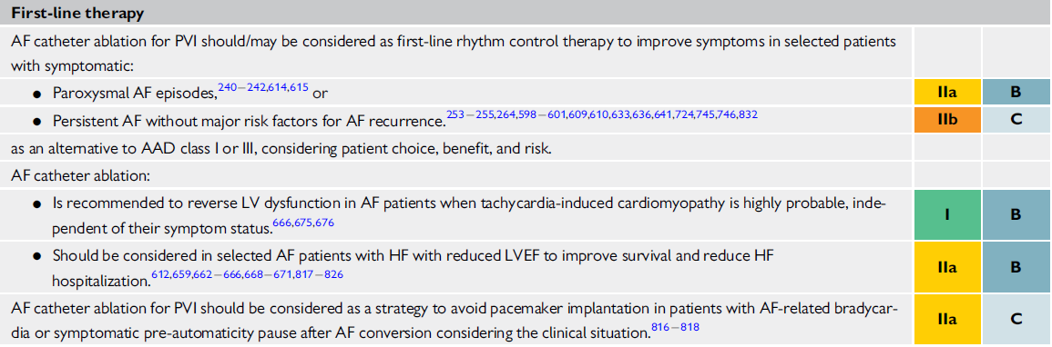
Indications for PVI as FIRST line treatment
Hindricks, G., et al. 2020 ESC Guidelines for the diagnosis and management of atrial fibrillation developed in collaboration with the European Association of Cardio-Thoracic Surgery (EACTS). European Heart Journal, 1–126. 2020.
11-th National Congress of the Azerbaijan Cardiology Society

Slide 19
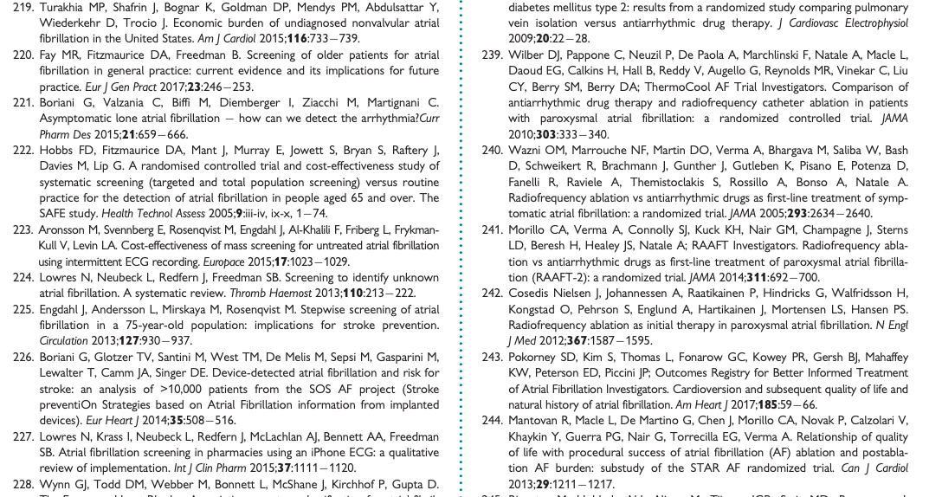
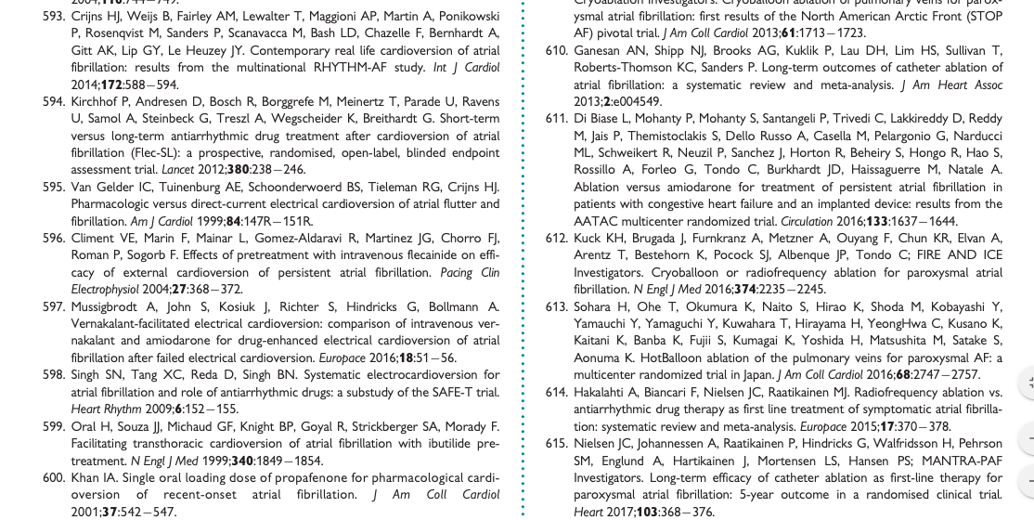
Indications for PVI as first line treatment - background
3 trials:
RAAFT 1
RAAFT 2
MANTRA PAF
+
1 meta analysis
11-th National Congress of the Azerbaijan Cardiology Society

Slide 20
PVI as first line treatment
Guidelines included trials:
RF trials
RAAFT 1
RAAFT 2
MANTRA PAF
Total 491 pts
New trials
CRYO
CRYOFIRST
STOP AF FIRST
EARLY AF
Total 748 pts
More data/more pts included+additional technology evaluated
More evidence supporting PVI as first line/early treatment especially for paroxysmal AF
11-th National Congress of the Azerbaijan Cardiology Society

Slide 21
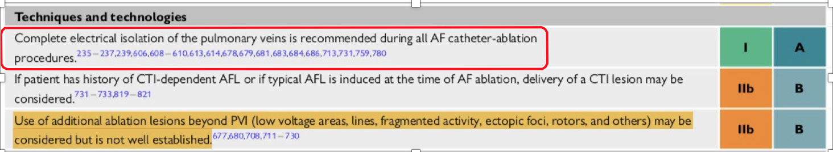
11-th National Congress of the Azerbaijan Cardiology Society

Slide 22
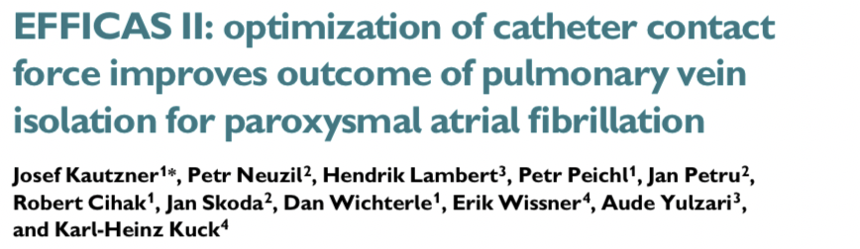
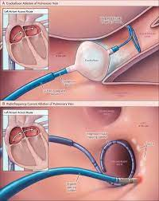
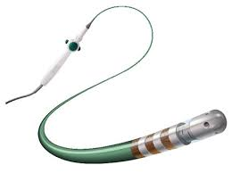
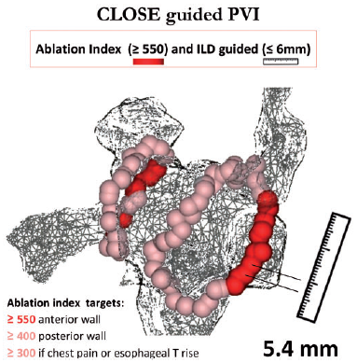
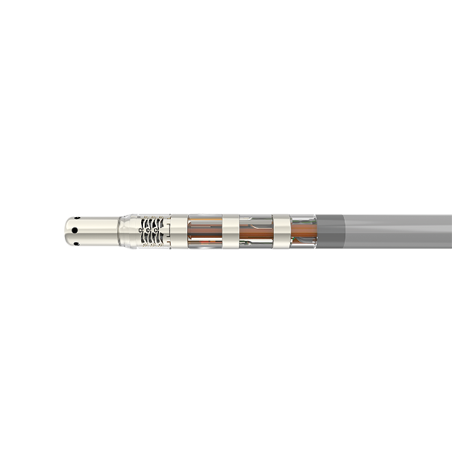
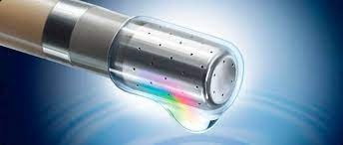
PVI – improvement in techniques/technologies increases success rates
Phlips T et al. Europace. 2018.
Kautzner J et al, Europace 2015
Kuck KH et al, NEJM 2016
11-th National Congress of the Azerbaijan Cardiology Society

Slide 23
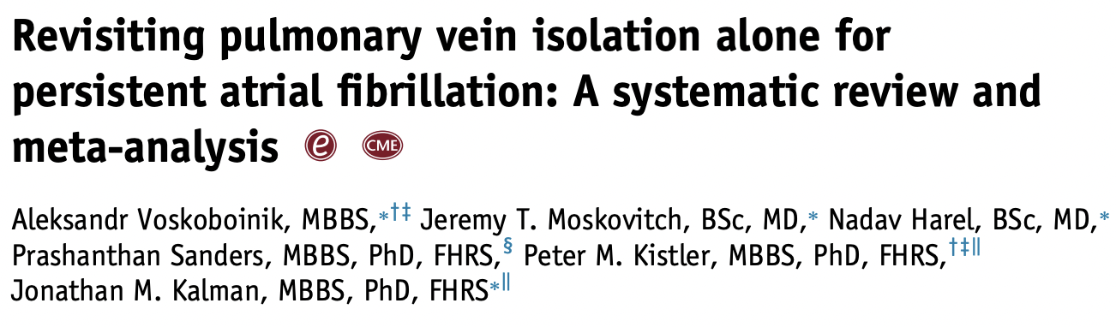
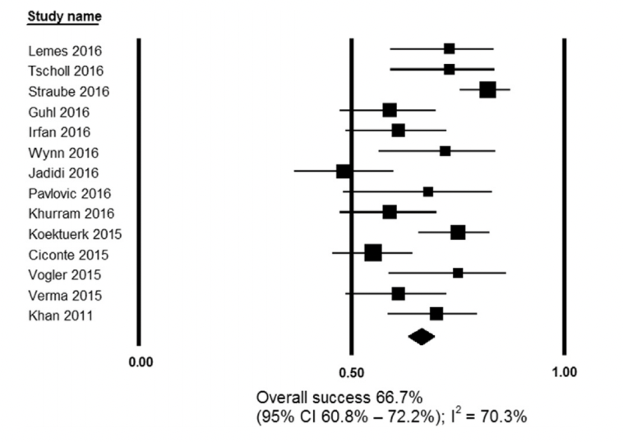
DOES PVI only work?
14 studies including PVI only
956 patients
45% RF 55% CB
12 m. success rates 66.7%
Only 3 are RCTs
Quality of studies, heterogeneity
SHORT FOLLOW UP
11-th National Congress of the Azerbaijan Cardiology Society

Slide 24
What to do beyond PVI?
2017 HRS/EHRA/ECAS Consensus Statement on AF ablation. Calkins H et al. Heart Rhythm. 2017;14:275-444.
11-th National Congress of the Azerbaijan Cardiology Society

Slide 25
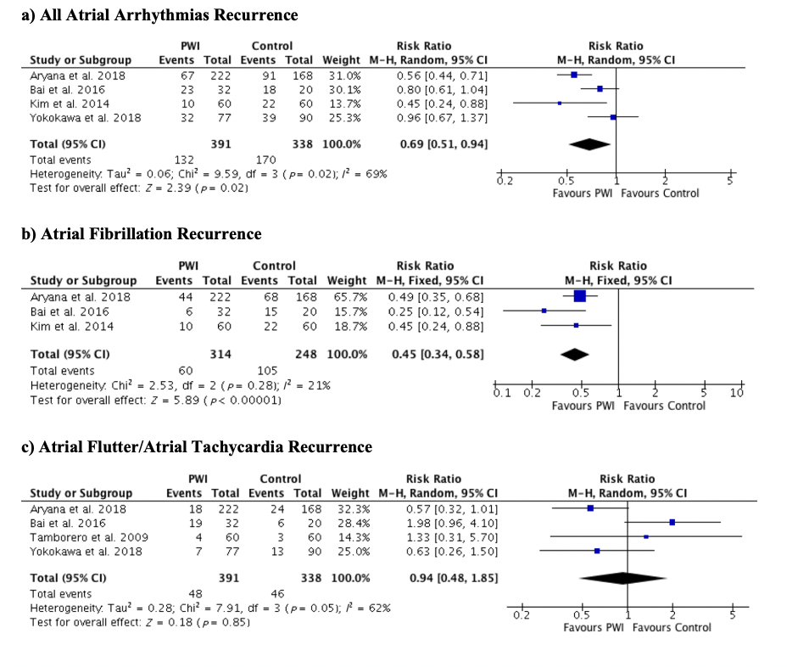
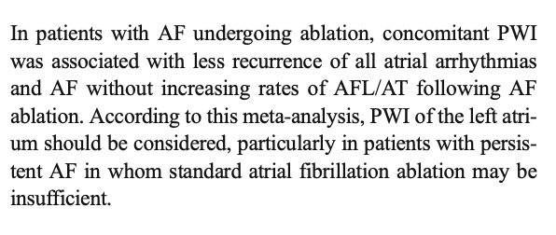
What to do beyond PVI – posterior wall isolation (PWI)
11-th National Congress of the Azerbaijan Cardiology Society

Slide 26
What to do beyond PVI?
2017 HRS/EHRA/ECAS Consensus Statement on AF ablation. Calkins H et al. Heart Rhythm. 2017;14:275-444.
11-th National Congress of the Azerbaijan Cardiology Society

Slide 27
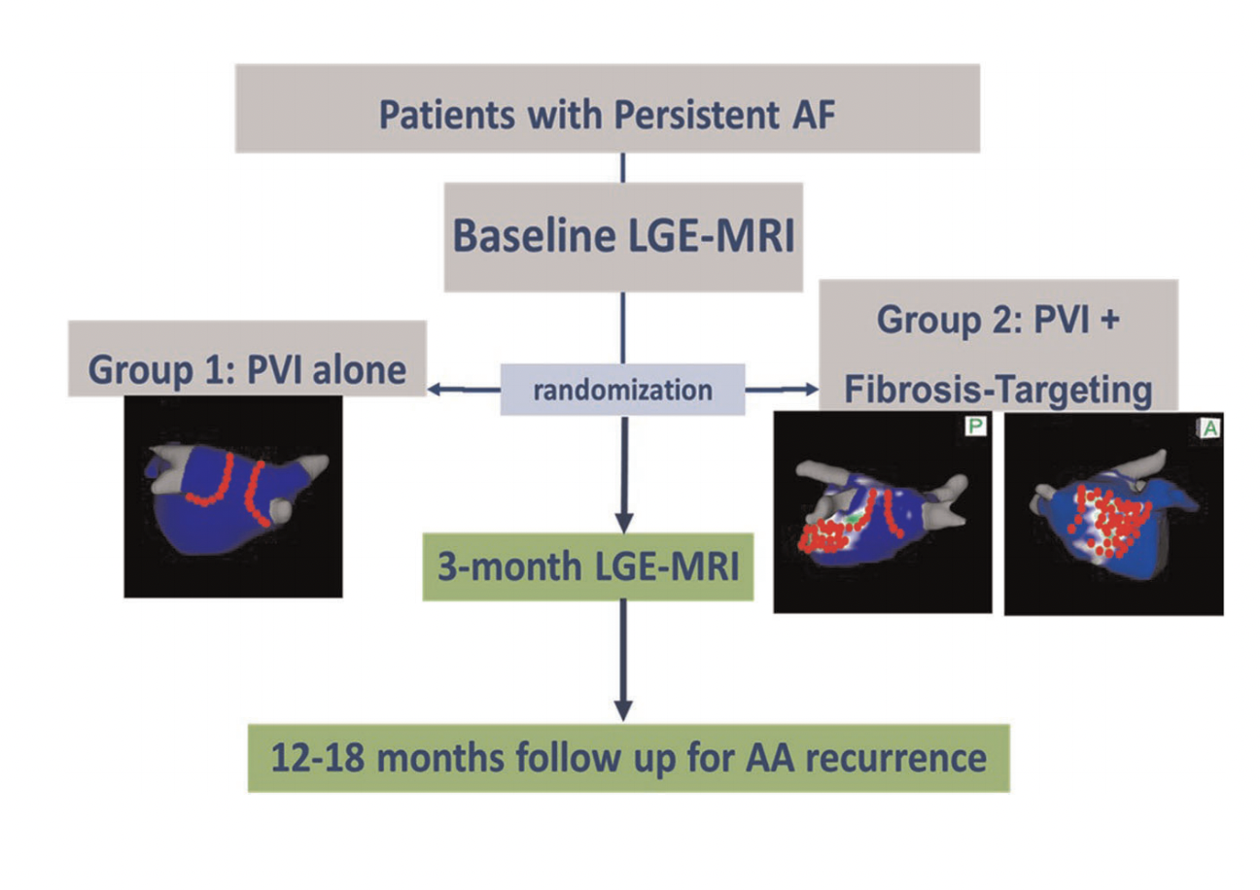
Substrate/fibrosis guided
DECAAF II Trial
ITT analysis – no difference in AF recurrence
More strokes in fibrosis guided group (p=0.013)
Marrouche et al. PRESENTED @ ESC 2021
11-th National Congress of the Azerbaijan Cardiology Society

Slide 28
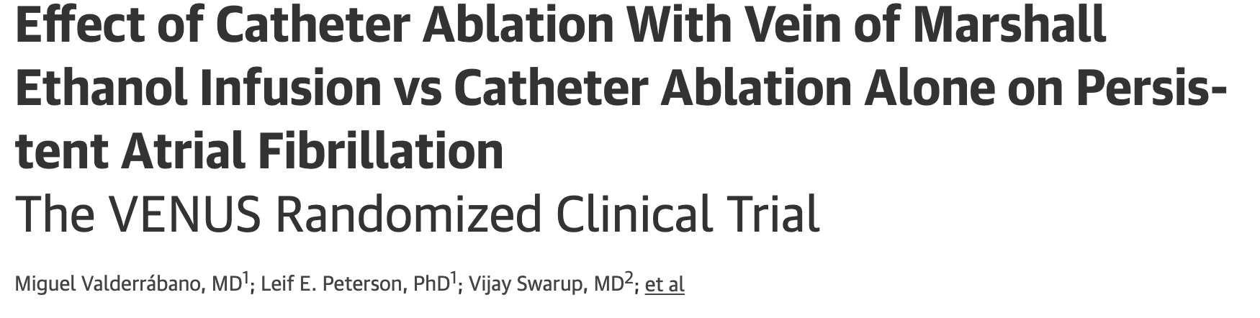
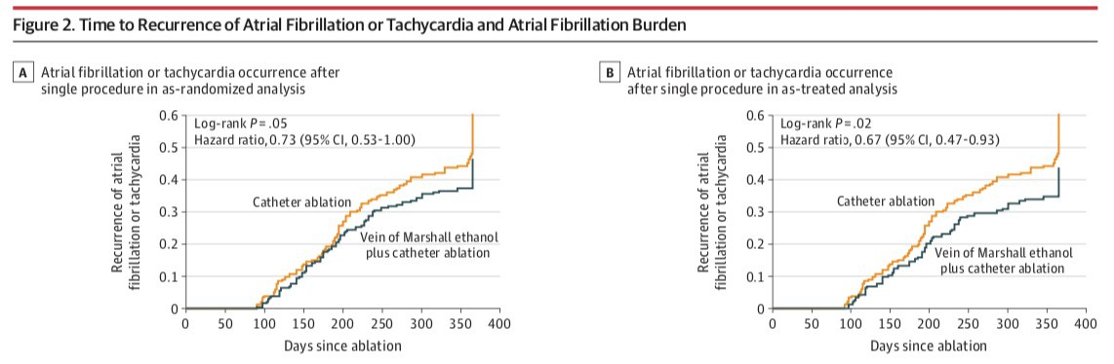
Ethanol infusion
in the vein of Marshall
350 Persistent AF patients
Randomized to CA or CA+ VoM AA
VoM AA increased likelihood of being AF free
11-th National Congress of the Azerbaijan Cardiology Society

Slide 29
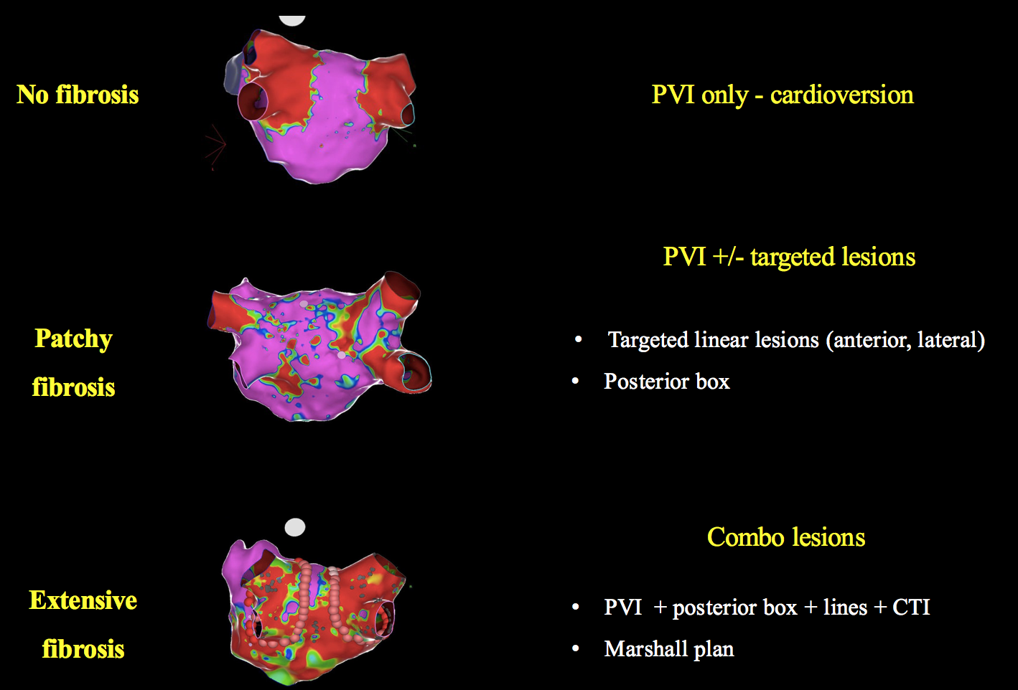
What we are treating?
11-th National Congress of the Azerbaijan Cardiology Society

Slide 30
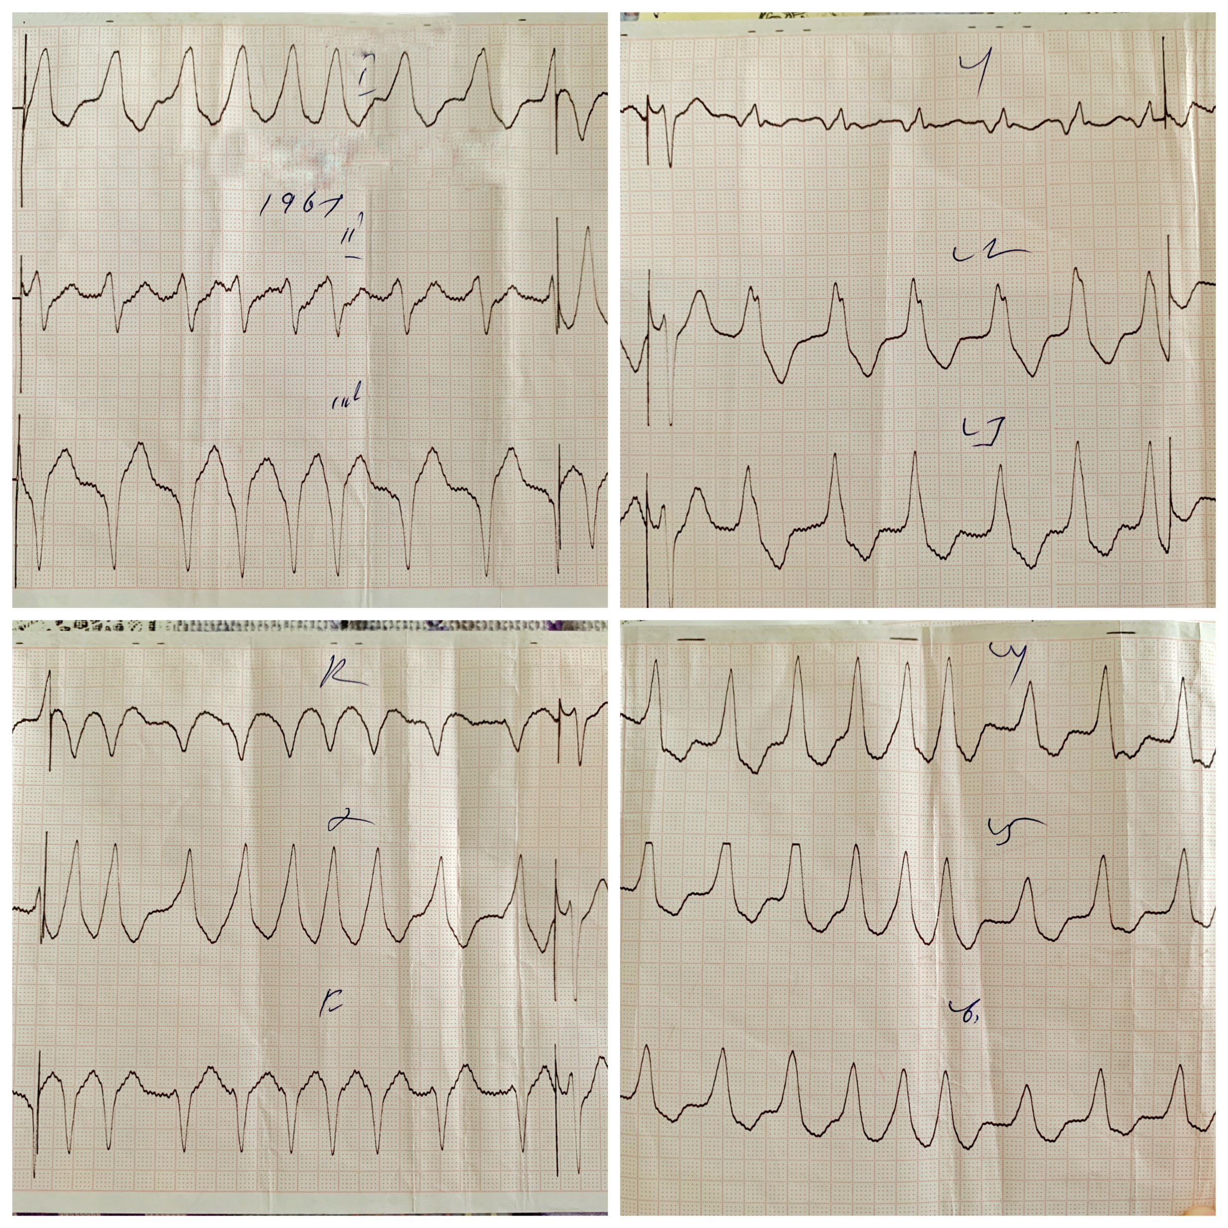
Case report: Patient N. 59 y.o.
7 years suffering from tachycardia.
DS: WPW syndrome.
In 2017 catheter ablation was performed.
After 3 years patient was taken by ICU with arrhythmia.
After consultation patient was send to our hospital for further management.
WAS TREATED LIKE – VT
BUT IT IS Afib with WPW
11-th National Congress of the Azerbaijan Cardiology Society

Slide 31
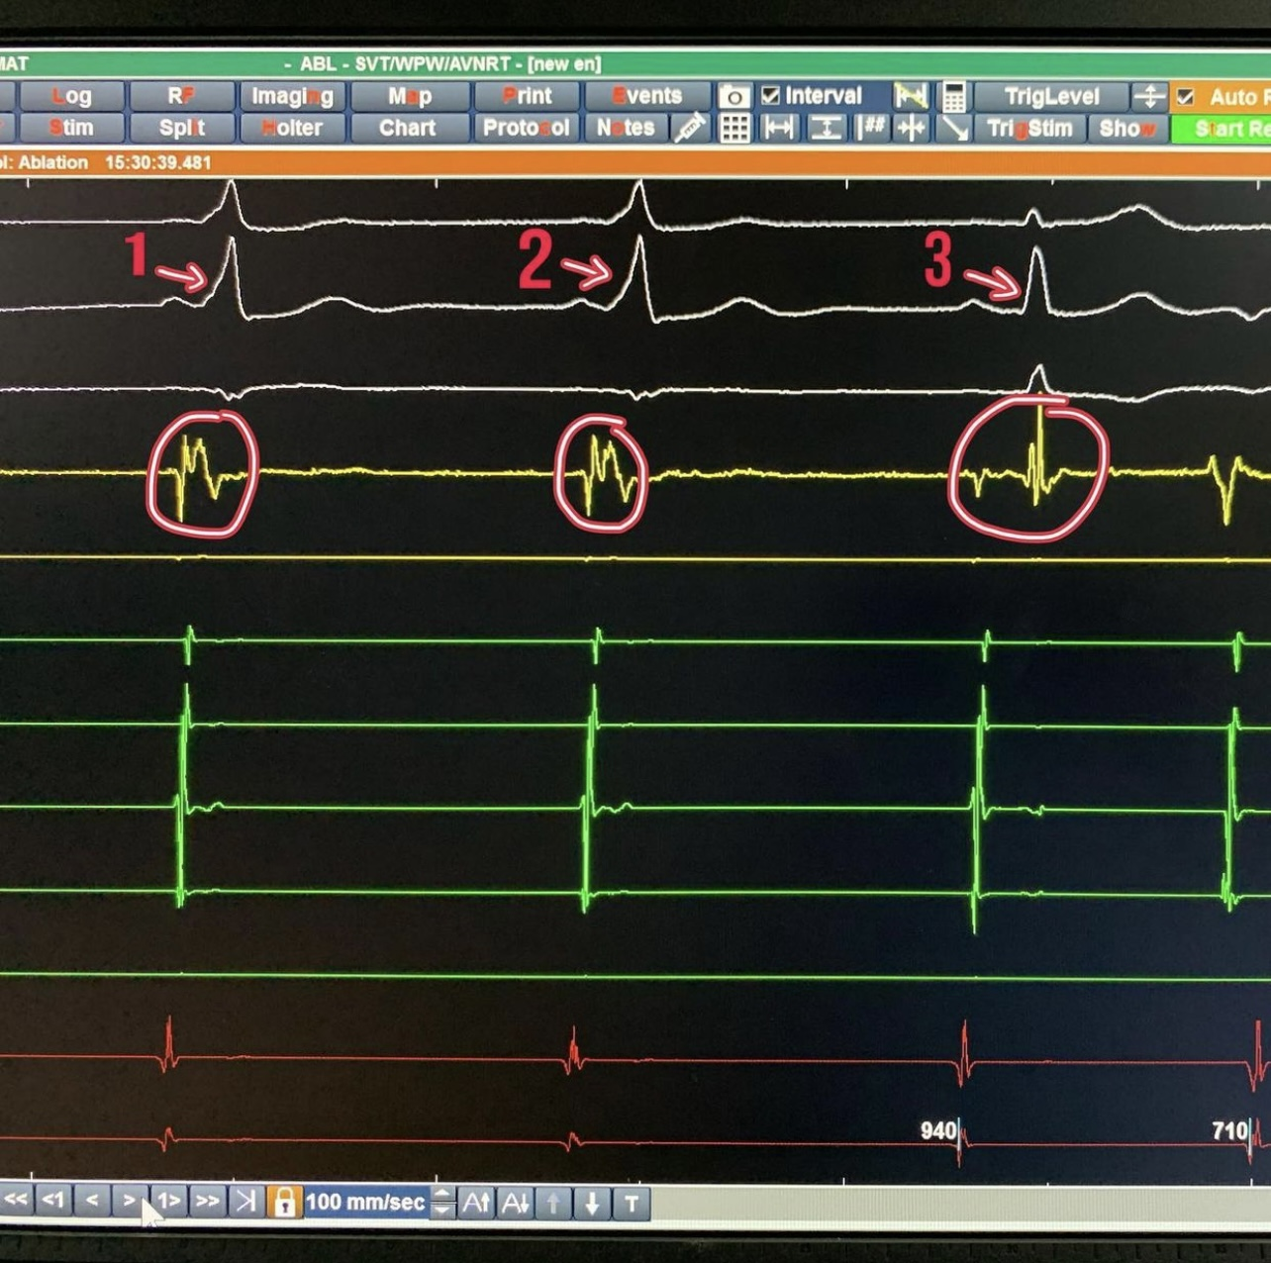
Electrophysilogical study (EP)
11-th National Congress of the Azerbaijan Cardiology Society

Slide 32
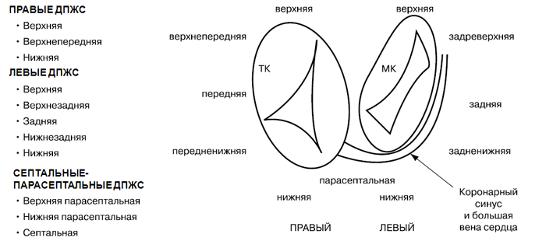
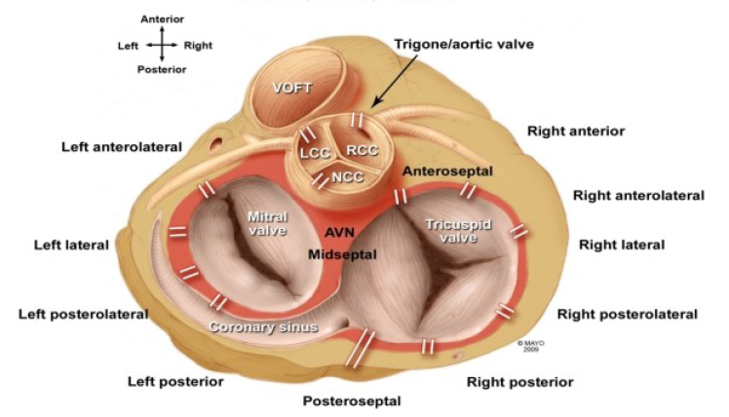
Anatomical localization of WPW by F.G. Cosio
11-th National Congress of the Azerbaijan Cardiology Society

Slide 33
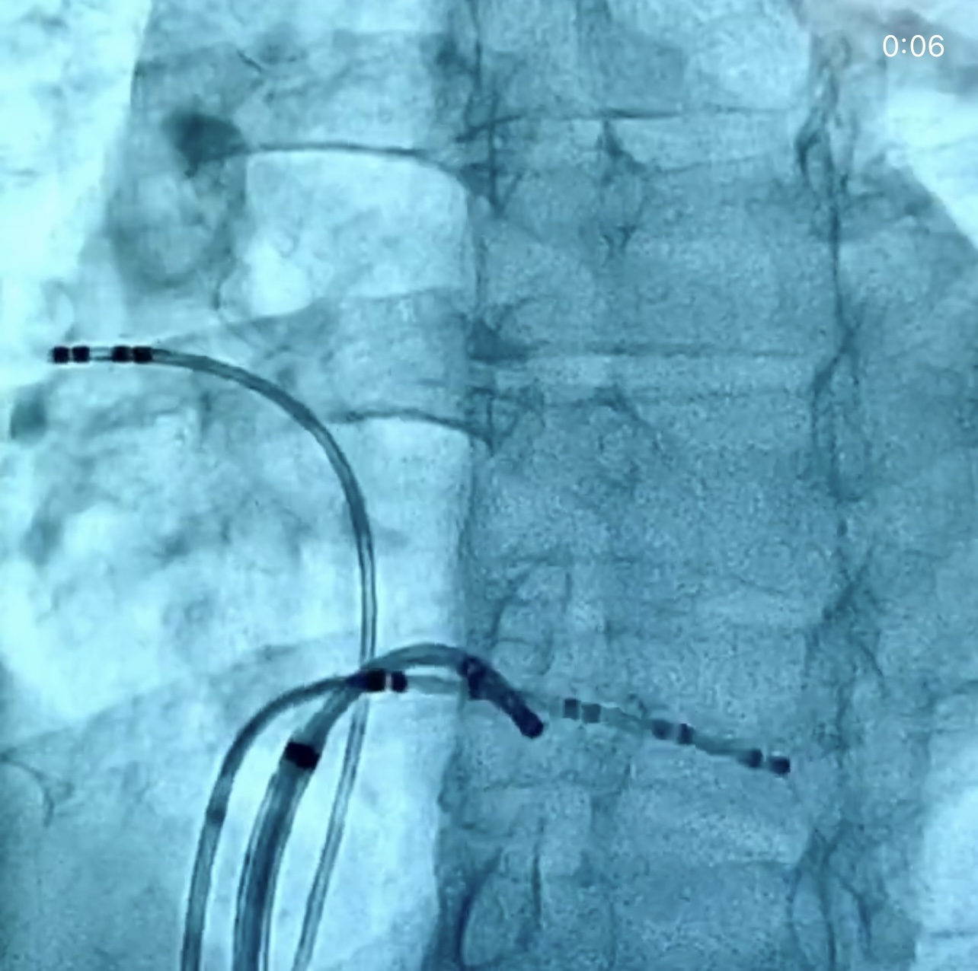
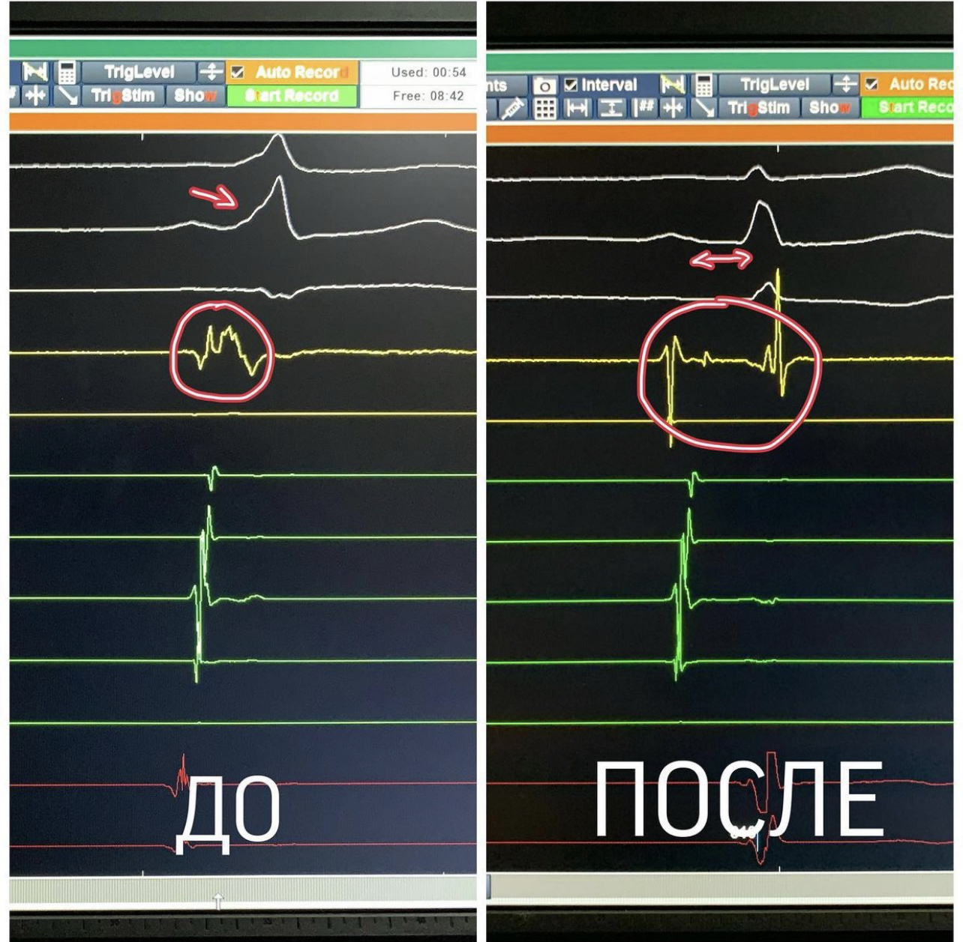
Radiofrequency ablation (RFCA)
11-th National Congress of the Azerbaijan Cardiology Society

Slide 34

Team Work

Slide 35
Take home message:
«Heart Team»
A
cardiologist, anesthesiologist, arrhythmologist,
endovascular surgeon, cardiac surgeon
Follow the algorithm «CC to ABC»
B
CC – Confirm & Charactirize
ABC – Anticoagulation / Better sympt. cont. / Comorbidities
Do the PVI and Do it RIGHT!
C
Do standardized approach + PWI + Marshall Plan or personalized based on fibrotic areas
D
Always REMEMBER «Patient first»
Do not forget that we are treating the patient, not the ECG
«Scientific Research Institute of Heart Surgery and Transplantation» Bishkek, Kyrgyz Republic

Slide 36
təşəkkürlər
thank you for attention
"If you Fail to Plan, you are Planning to Fail"
Benjamin Franklin
abai.turdubaev@gmail.com
+996 (700) 62-20-22
@abai.turdubaev
«Scientific Research Institute of Heart Surgery and Transplantation» Bishkek, Kyrgyz Republic

